Slide 1

Planning Department
2023-2024 Budget Report
Presenter:
Onno Husing

Slide 2
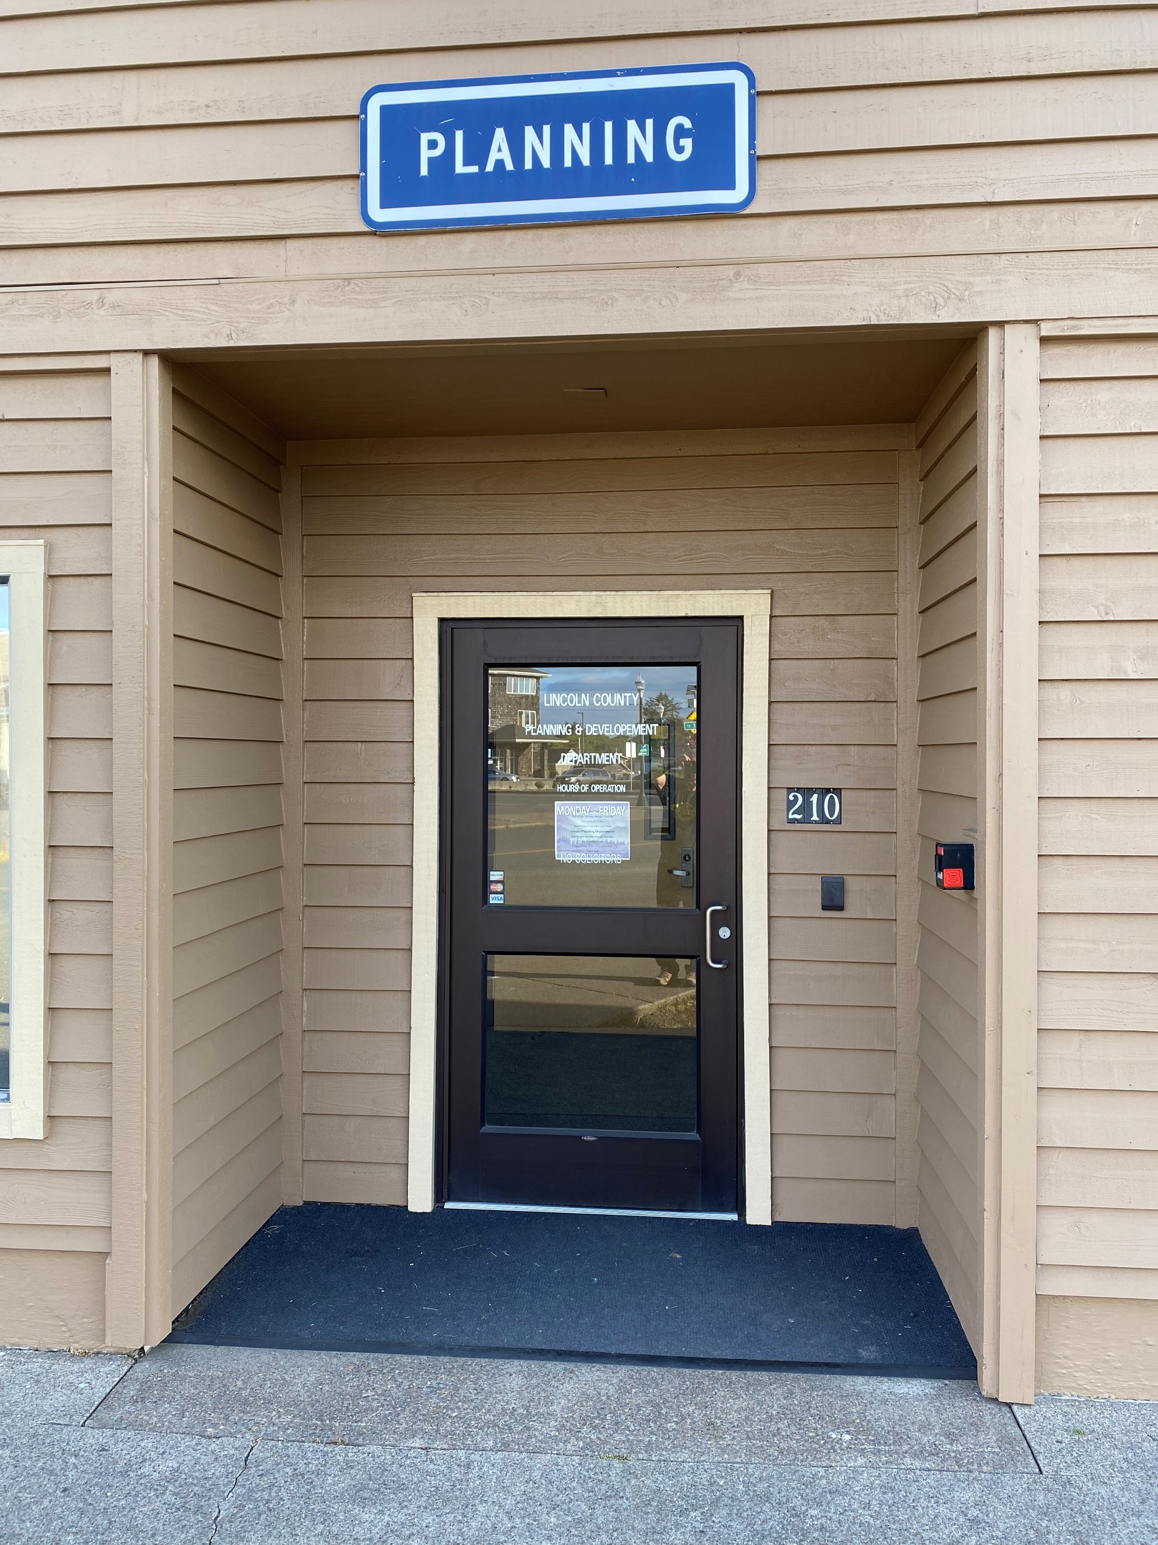
Overview
Three Separate Departments… Implementing Different State and Federal Laws… All Under One Roof:
Planning -- land use/zoning (overseen by Oregon DLCD) and FEMA)
Building -- building plan reviews/inspections (overseen by Oregon DCB and FEMA)
Onsite Septic -- septic system permitting and construction (overseen by Oregon DEQ)

Slide 3
Staffing
Office Staff – 12 full time FTE
Employee/Contract Services- 3 part time
Director
Building Official
Combination Inspector
Combination Inspector
Operations Supervisor
Permit Specialist
Permit Technician
Permit Technician
Senior Planner
Associate Planner
Senior EHS
EHS Trainee

Slide 4
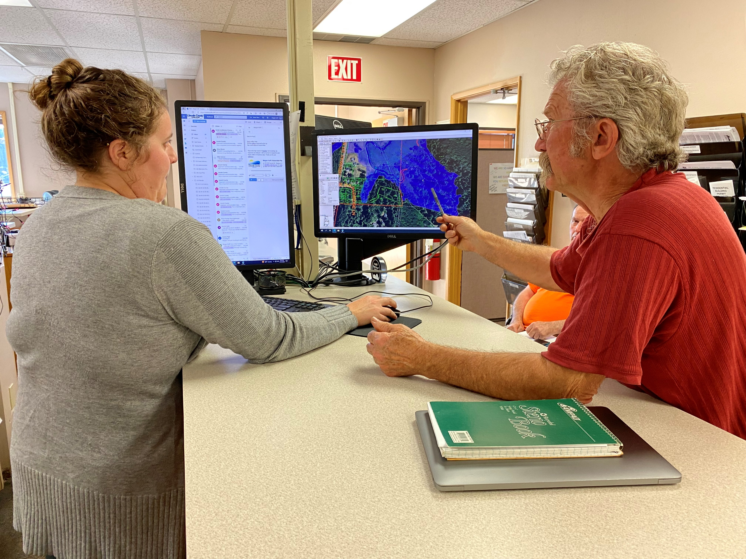
Serving The Public
Approximately 75+ Phone Calls Daily
Building permits
Onsite Septic Permits
Land Use Planning Applications
Phone Calls
Emails
Counter Visits
In-person appointments
Online/Zoom Meetings
Information Requests

Slide 5
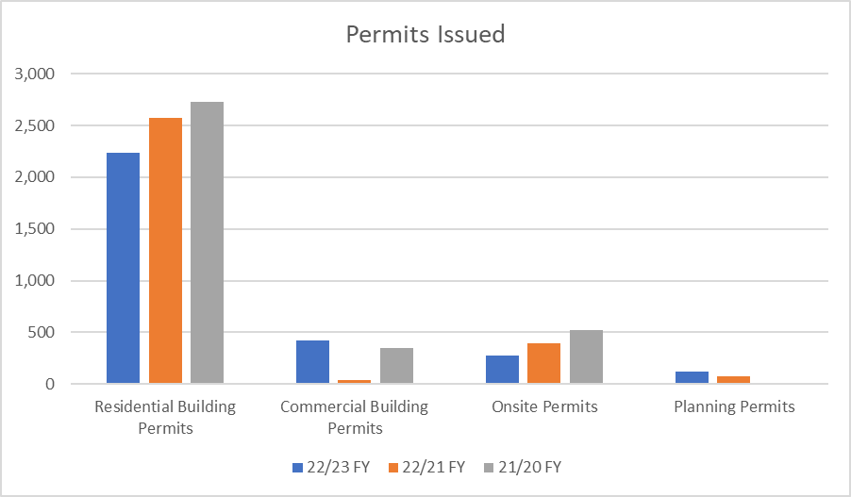
Yearly Issued Permits

Slide 6
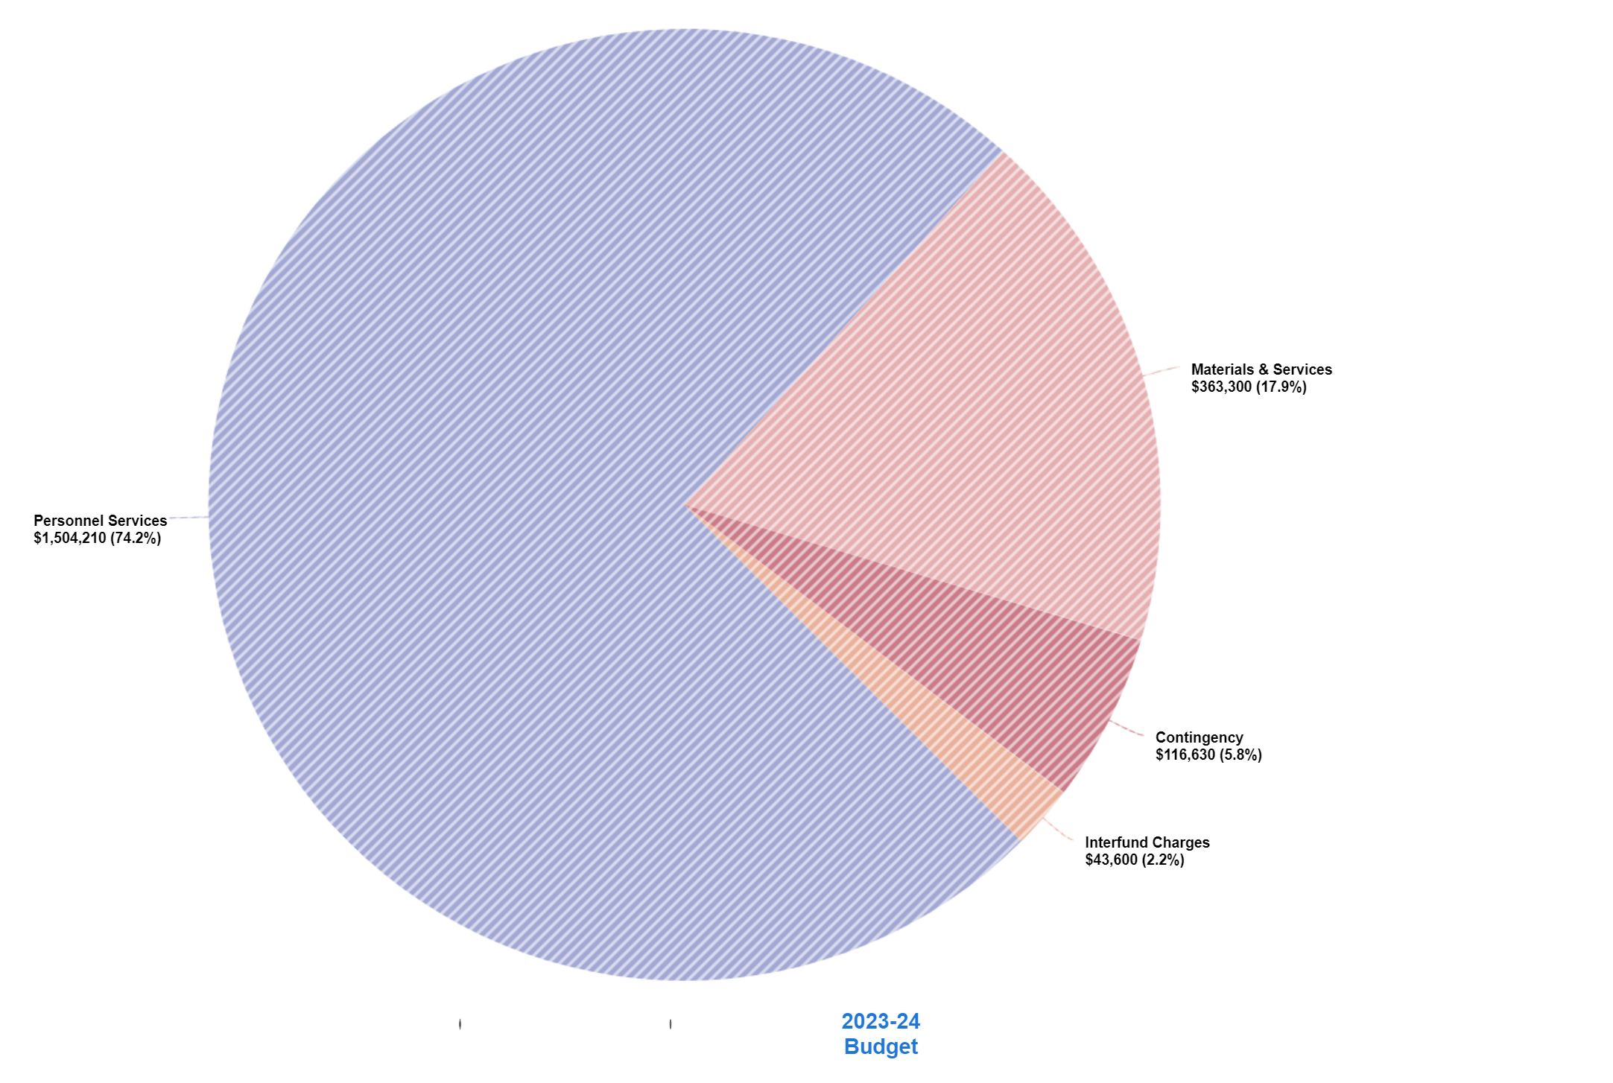
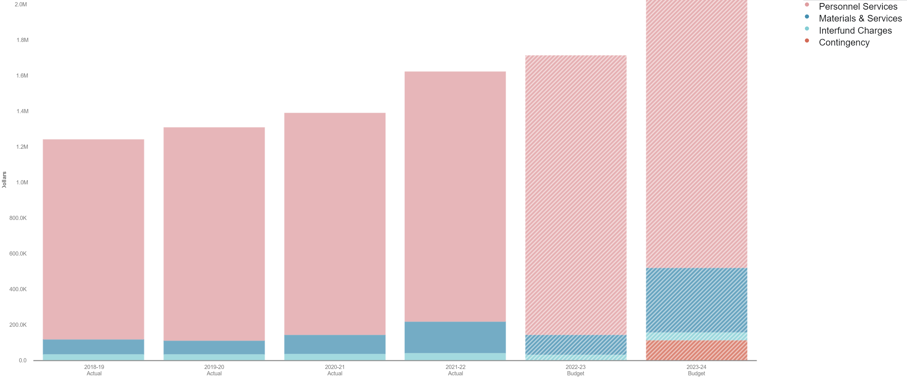
Budget 23/24 FY

Slide 7
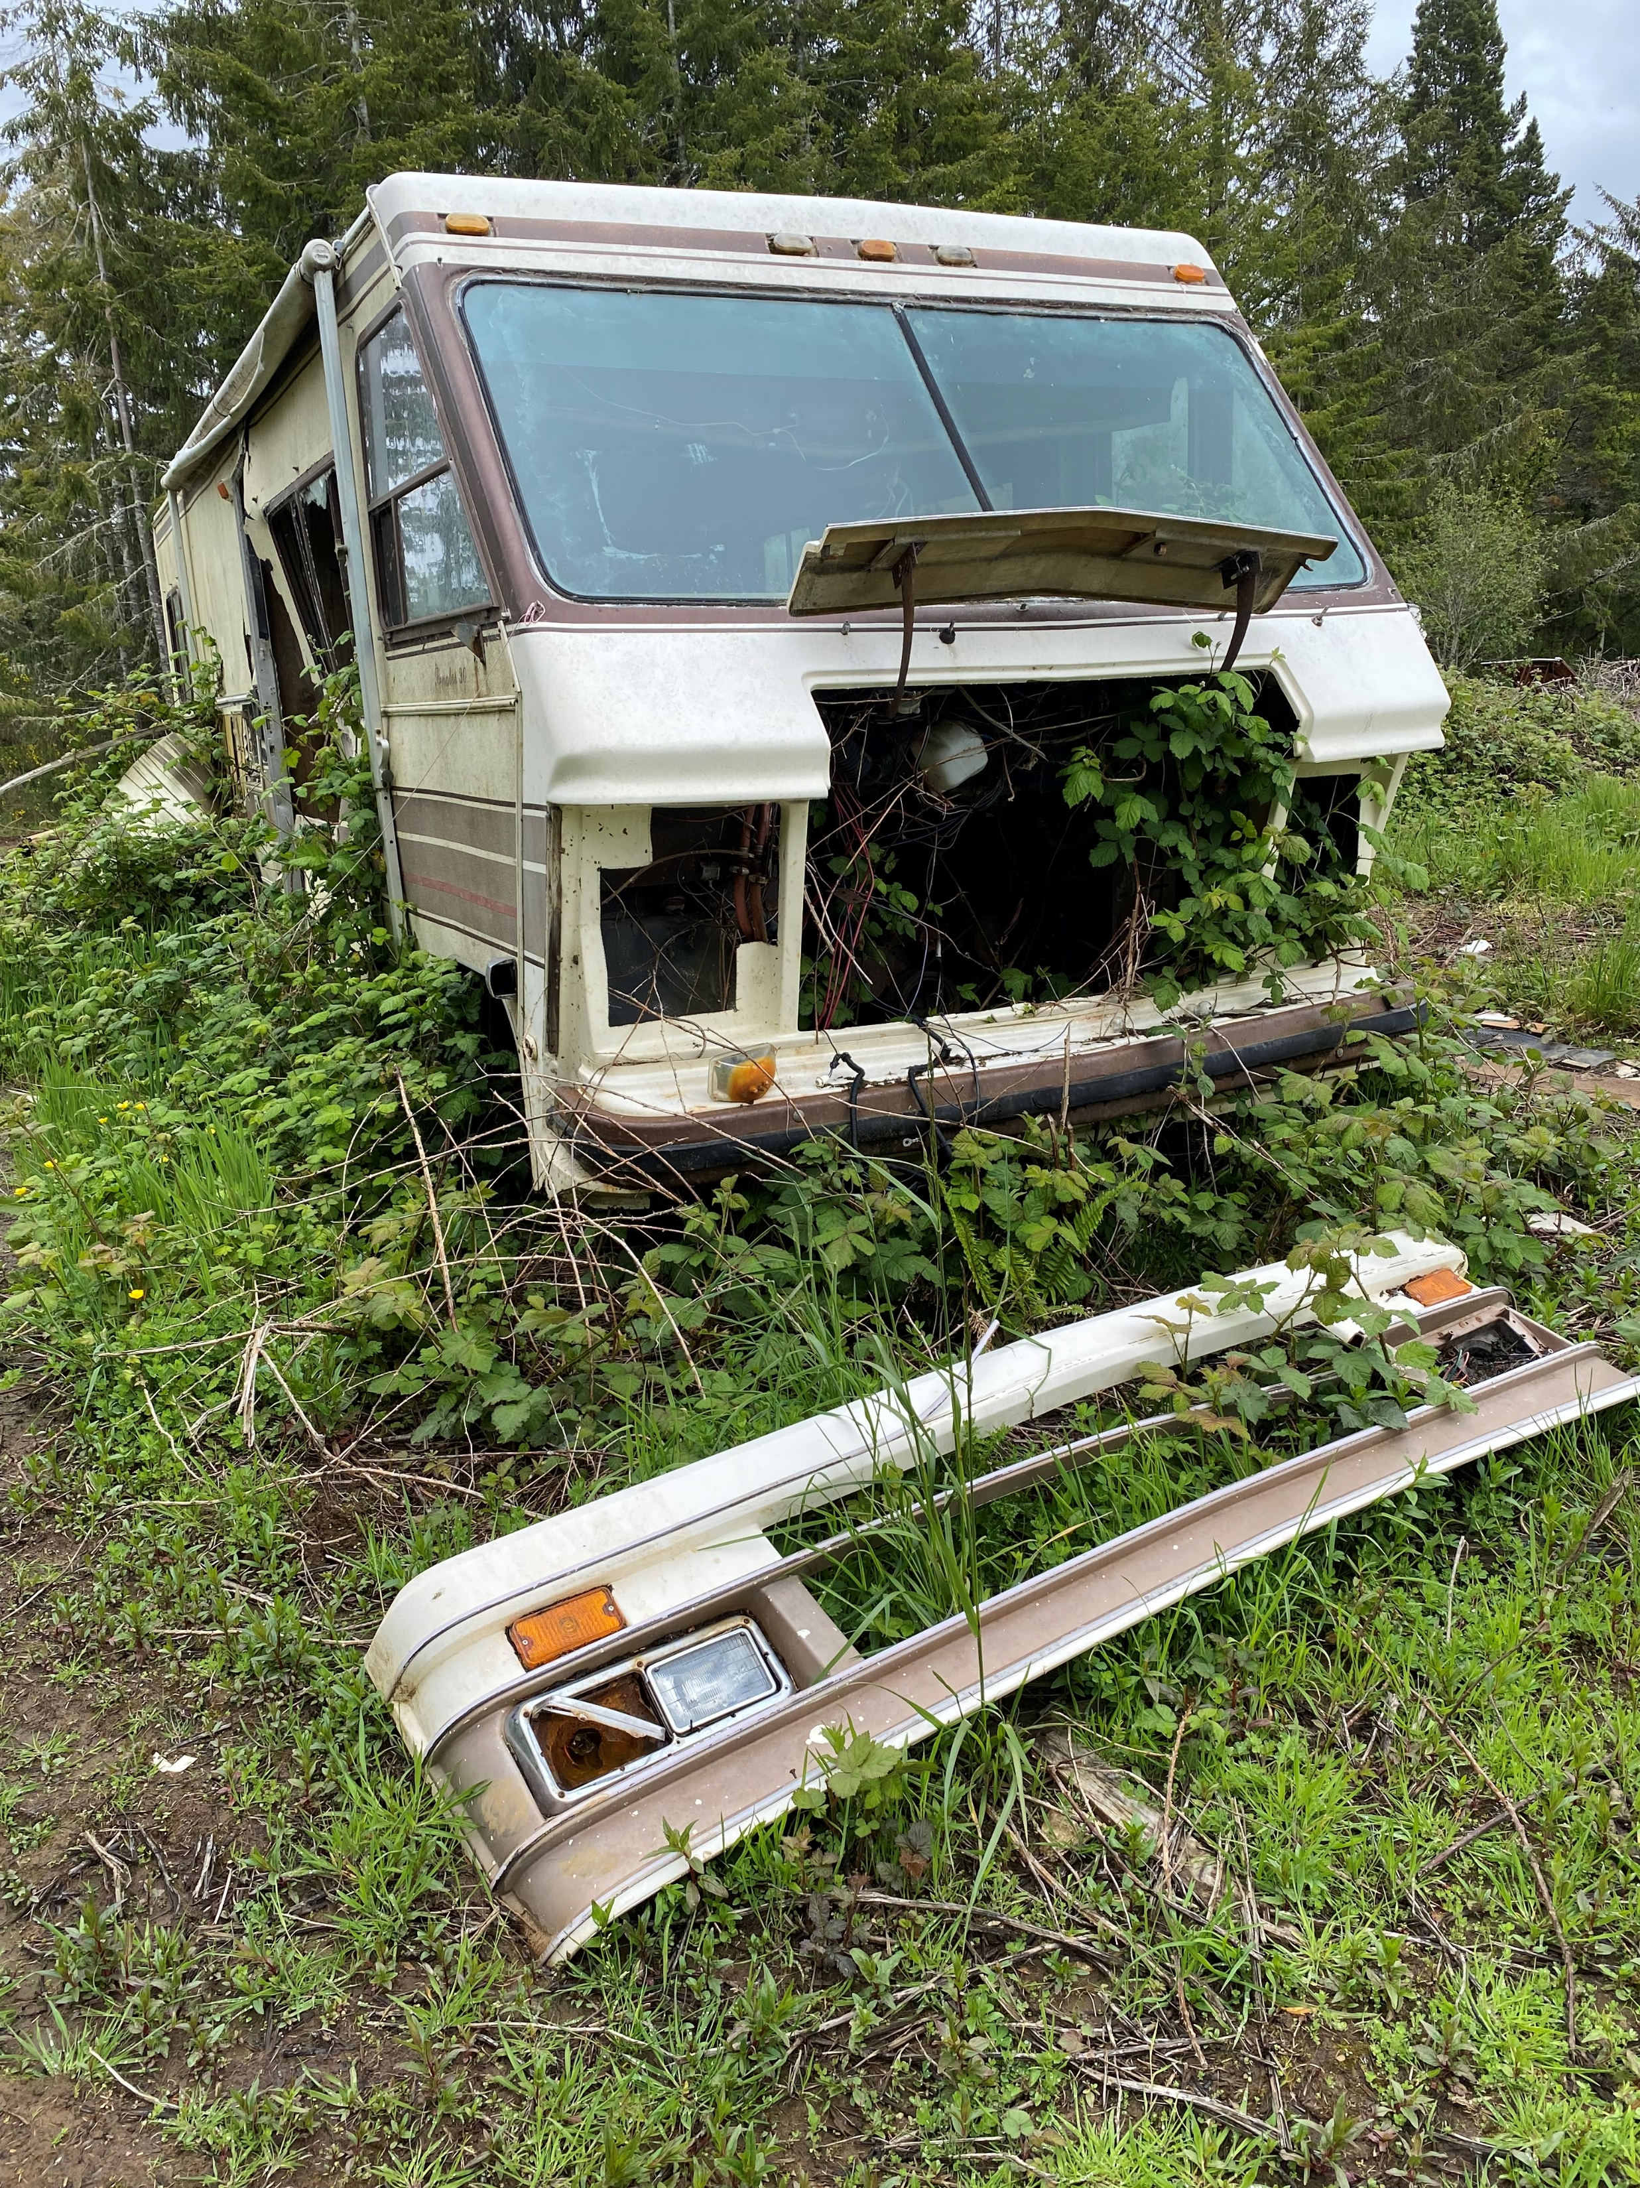
Code Enforcement
There’s no line item for code enforcement in Planning’s budget
Code enforcement, public health/safety, is a core County responsibility
The code enforcement team has improved – all the right players at the table:
      Lincoln County Sheriff’s Office (two code enforcement officers)
      Lincoln County Counsel
      Lincoln County Dept of Public Health
      Lincoln County Solid Waste
      Lincoln County Planning Department (planning/onsite septic/building codes)

Slide 8
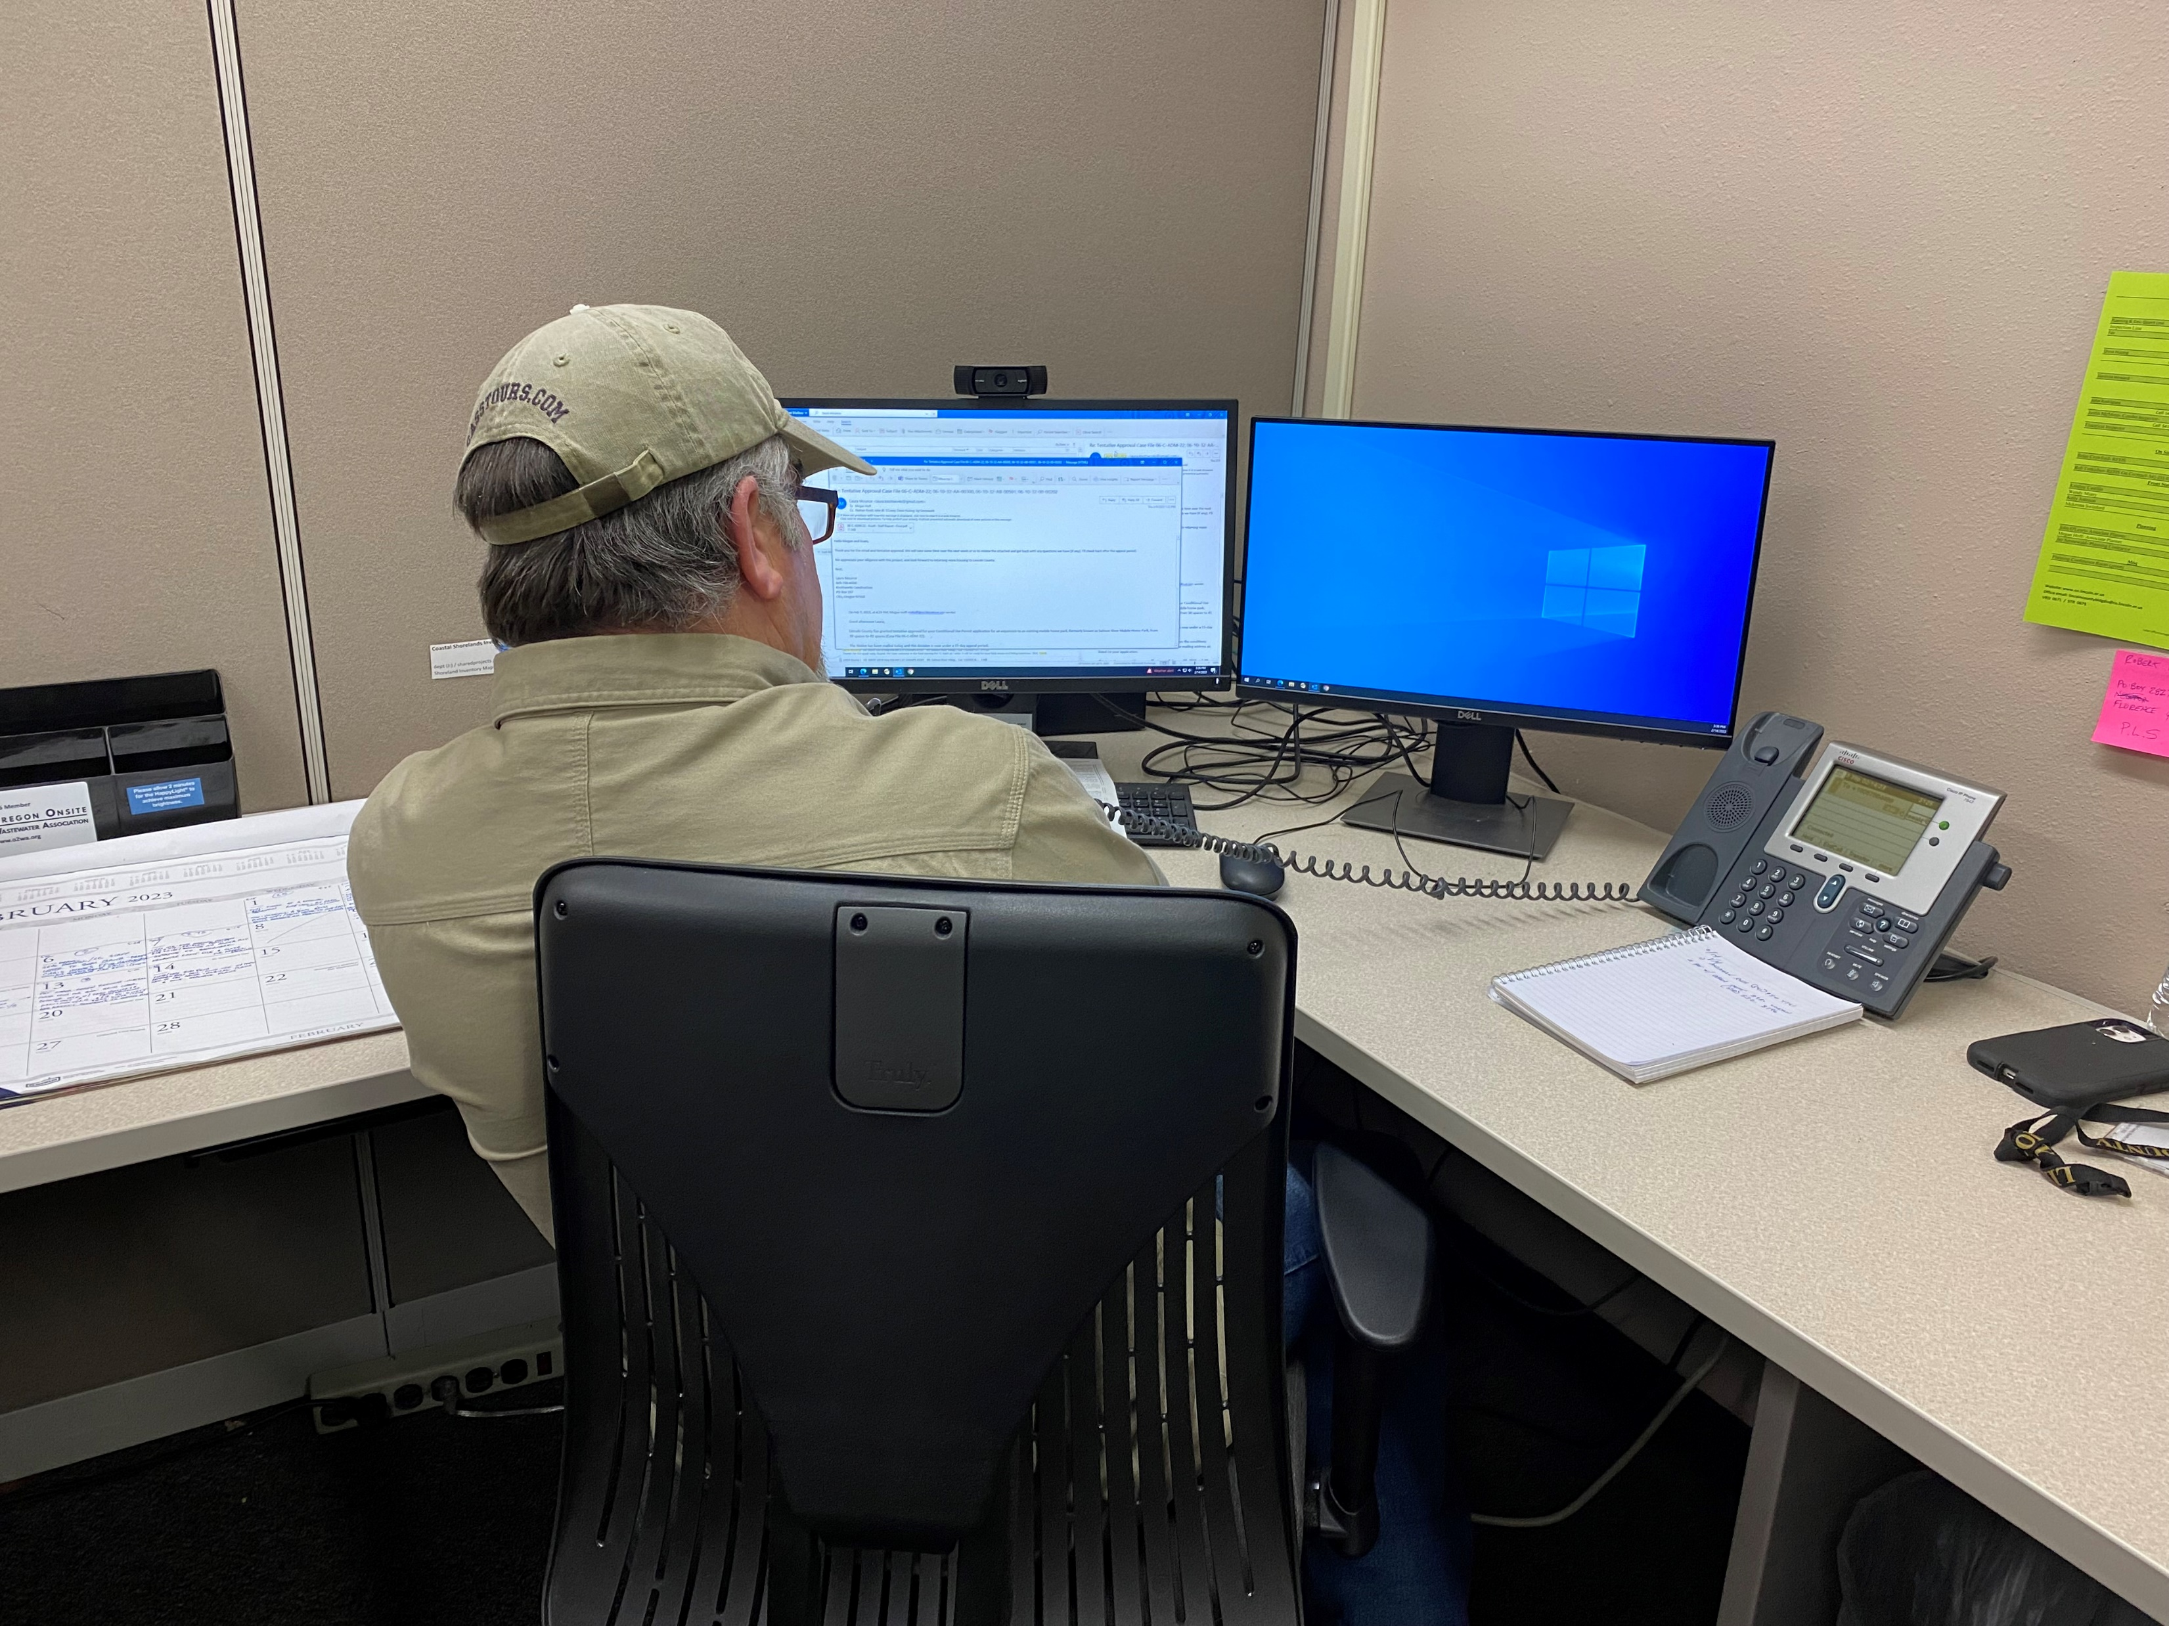
Contractual Services
Building & Electrical Funds (Enterprise accounts; fee-driven -- not General Fund)
:Planning Contractual Services (combo of Grants/General Fund/Fees).
-- Electrical Inspector position is presently outsourced to a third-part. Substantial savings will occur (over $100k) after we are able to hire a full time in-house electrical inspector.
-- Two Contract Planners – part time. High- skilled/experienced; lessons the acute need for a third full-time Planner.

Slide 9
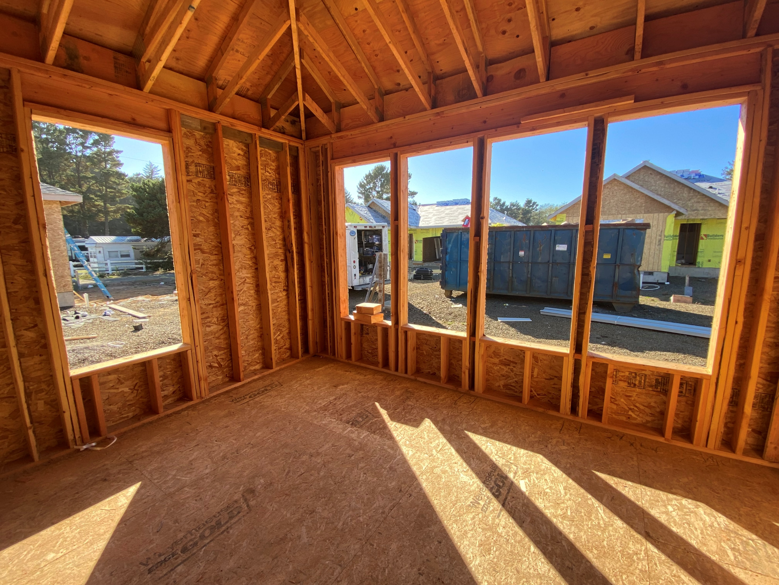
Adding Revenue
A major review of the Planning Department’s Budget yielded several key insights:
(1) Cost savings could be achieved from improved operations on processing fee payments,
(2) Fees Lincoln County has charged for planning permits and building permits are substantially lower than similar jurisdictions. We’re now playing catch up.
(3) Fees on Vacation Rentals enabled us to fund a much-needed second Environmental Health (EHS) position to address STR septic maintenance issues for that industry.
FINANCIAL OBJECTIVES -- (a) Build healthy reserves in the stand-alone Building Permit and Electrical Permit accounts, and (b) raise planning fees to invest in staff capacity and reduce reliance upon General Fund

Slide 10
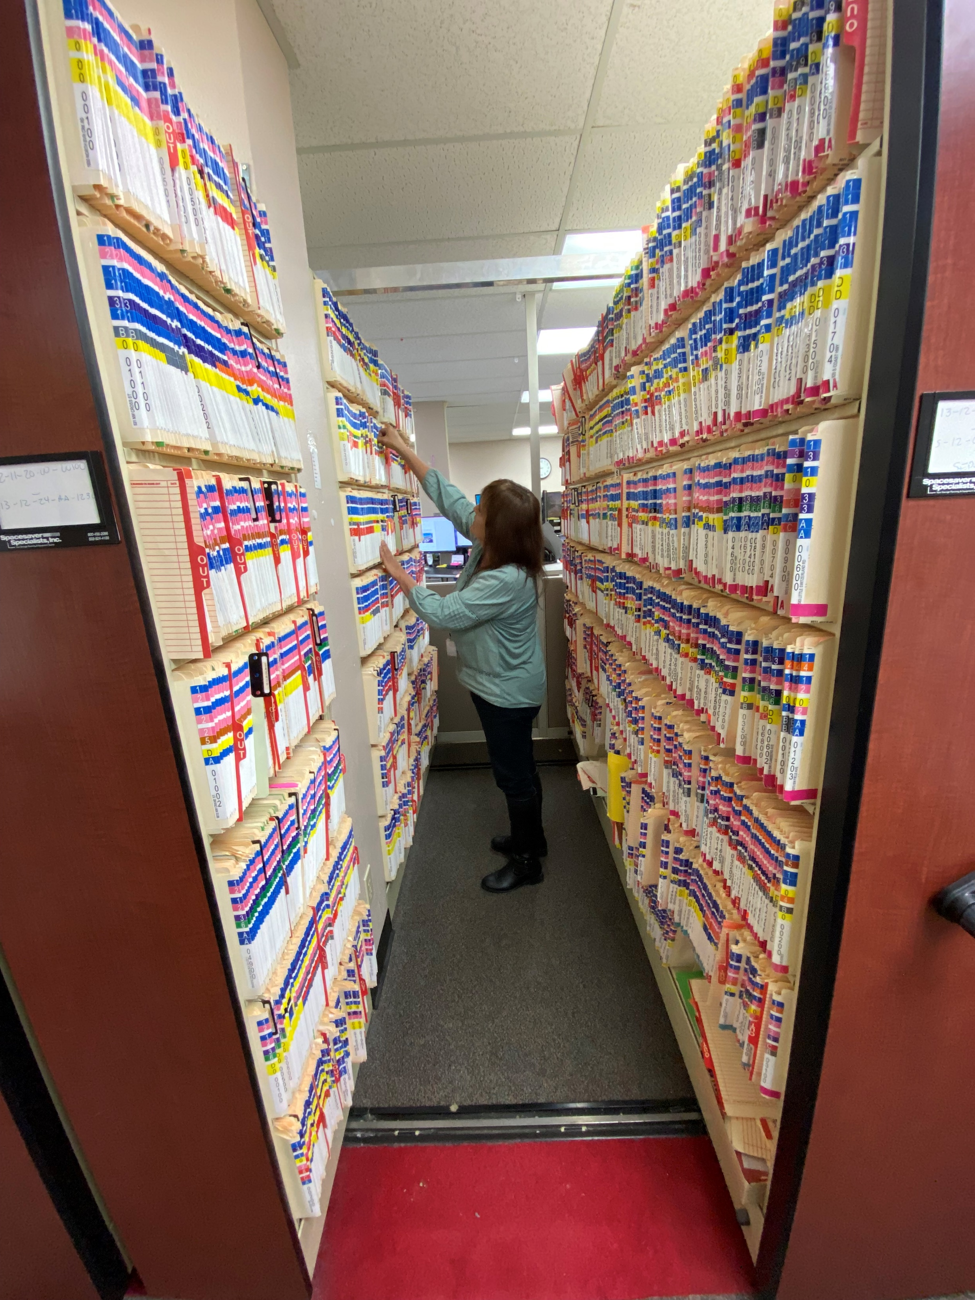
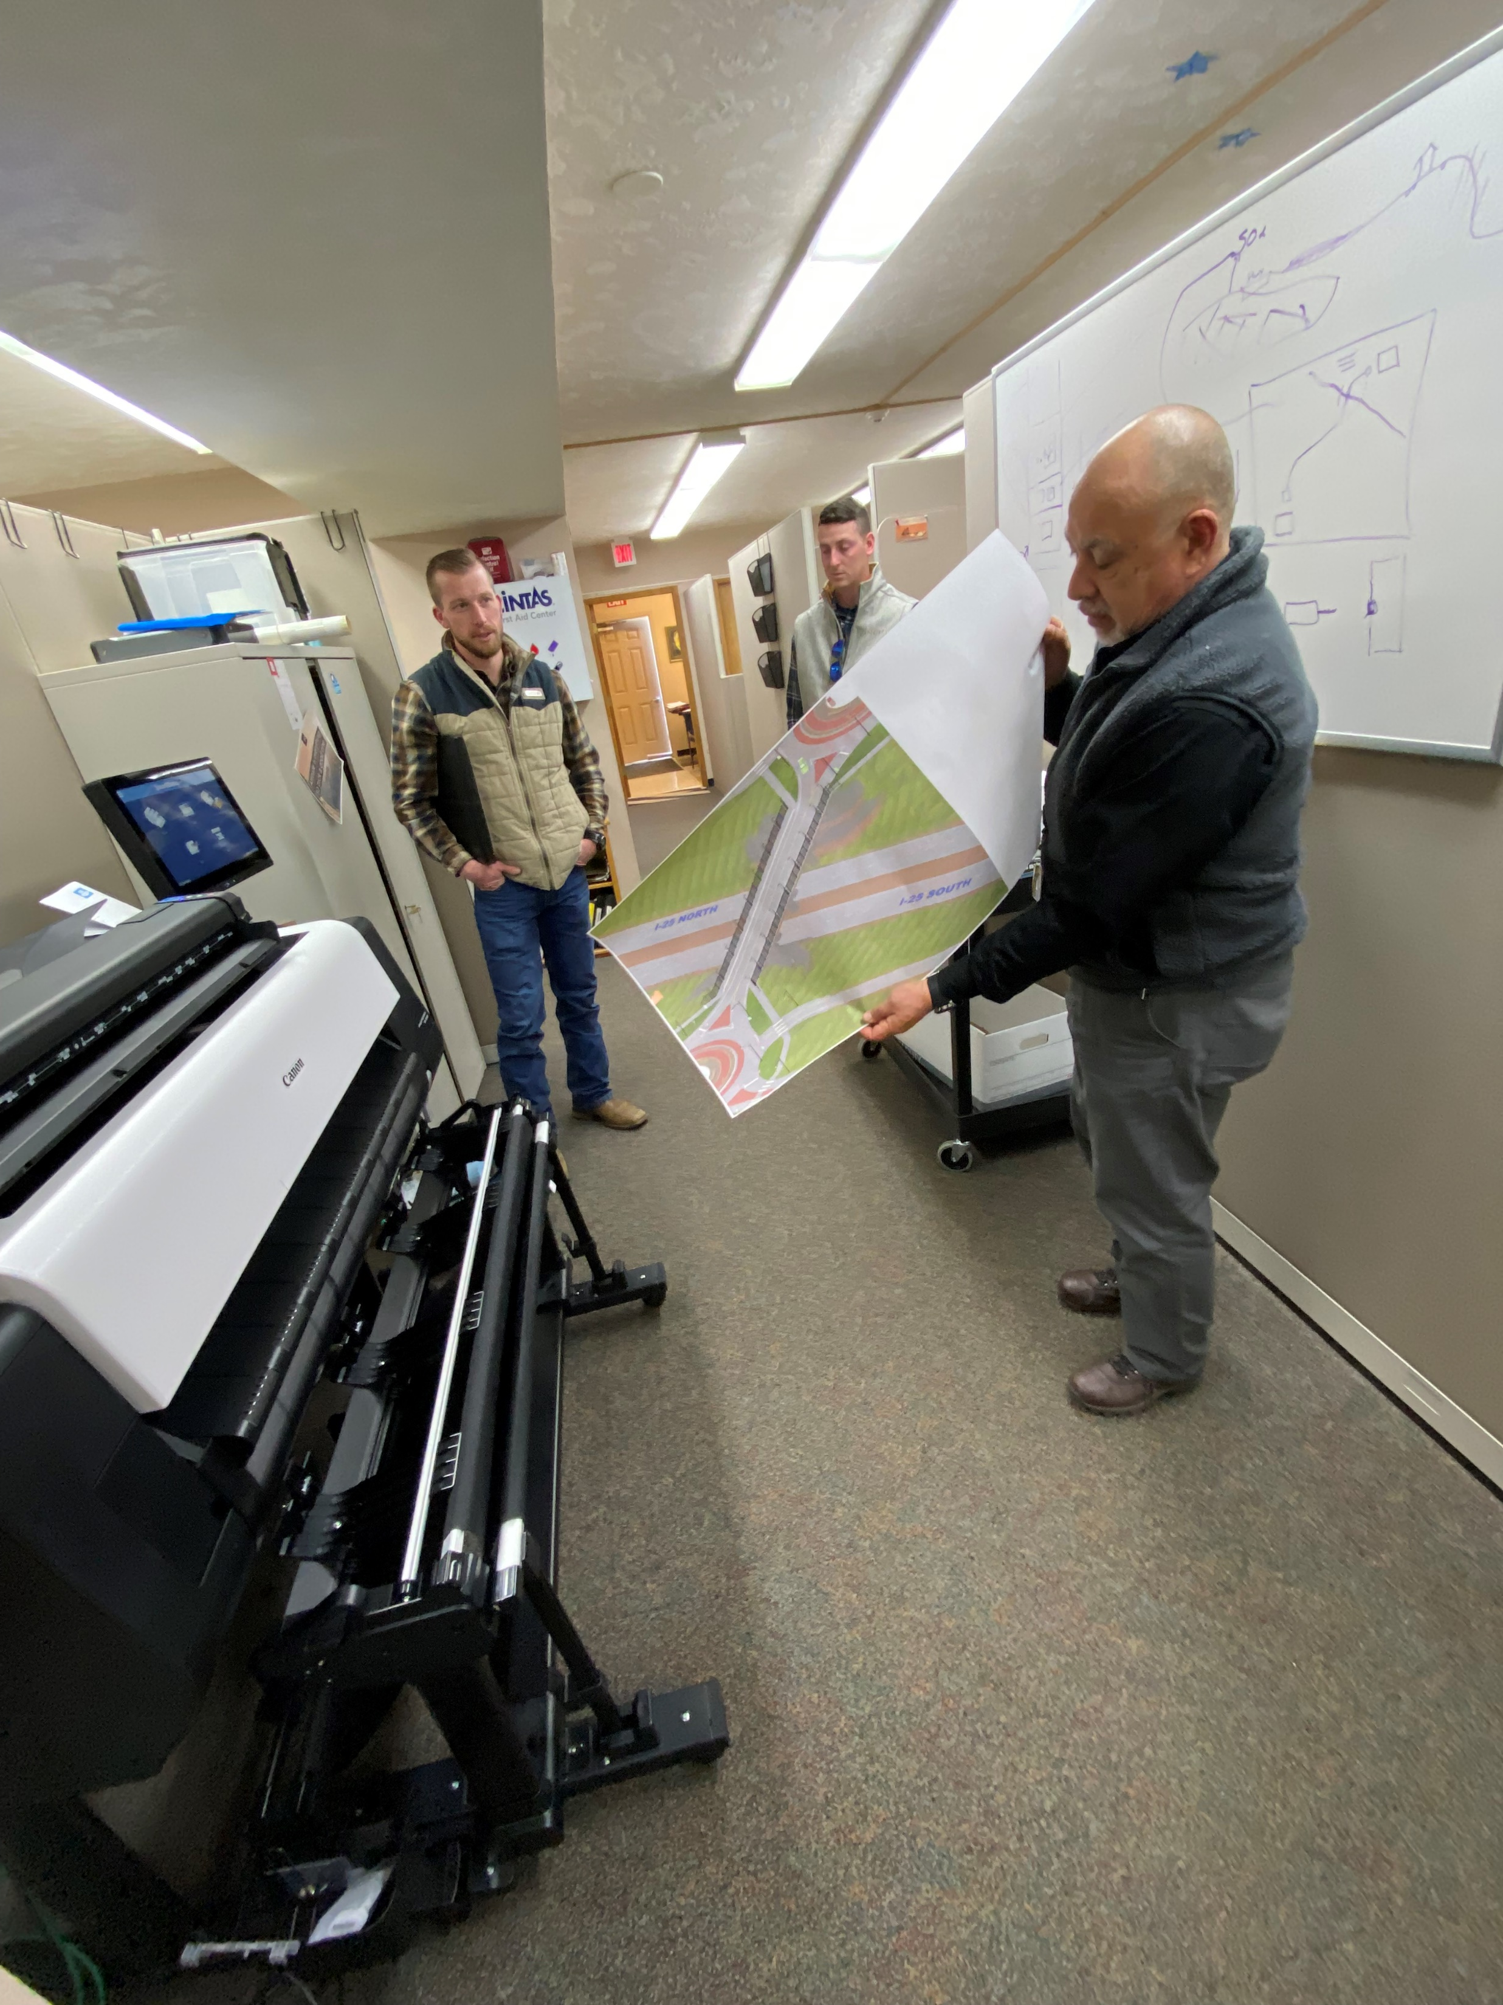
Improving Public Service
* Digitizing Department Records
We have, literally, thousands of hard copy files (onsite septic and planning) for properties in Lincoln County. Having these paper records digitized and posted online will enhance public access to these documents.
* A Fully-Electronic Office
All building plans submitted to our Department must now be done electronically. A new-specialized scanner enables paper plans to be converted into digital documents. New monitors facilitate digital review of plans.

Slide 11
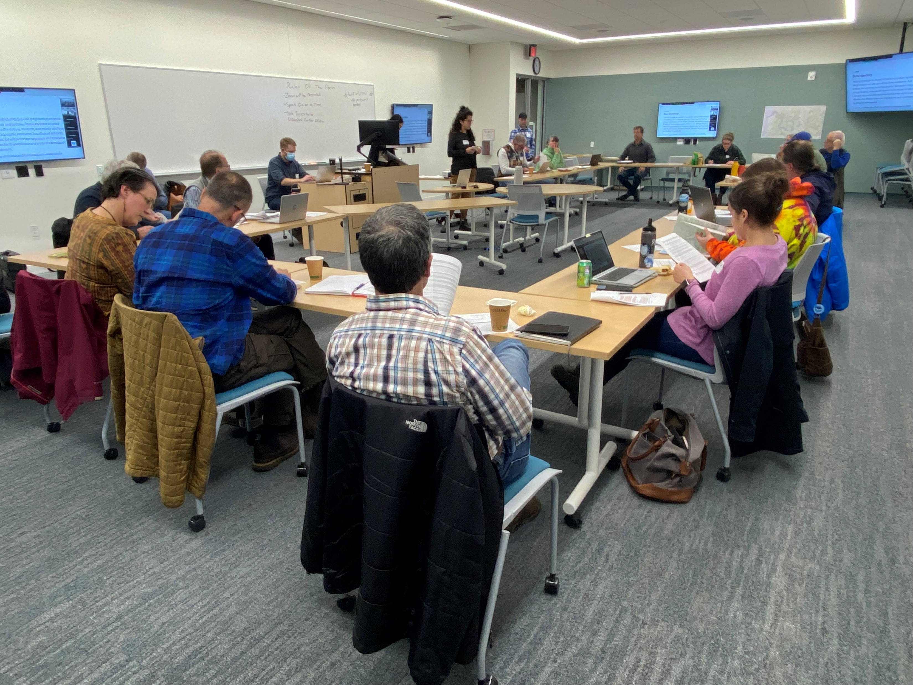
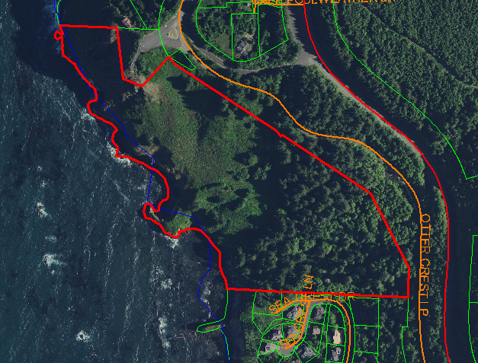
Other Initiatives
Update of the Yaquina Bay Estuary Management Plan (grant funded)
Update of National Hazard Mitigation Plan (NHMP) (grant funded)
Preserving Iconic Places (Lincoln County Land Legacy Program)
The entire South Side of Cape Foulweather was vulnerable to development. The Planning Dept. worked with the conservation community and the Siletz Tribe (CTSI) to preserve the property and have it donated to CTSI.

